Slide 1



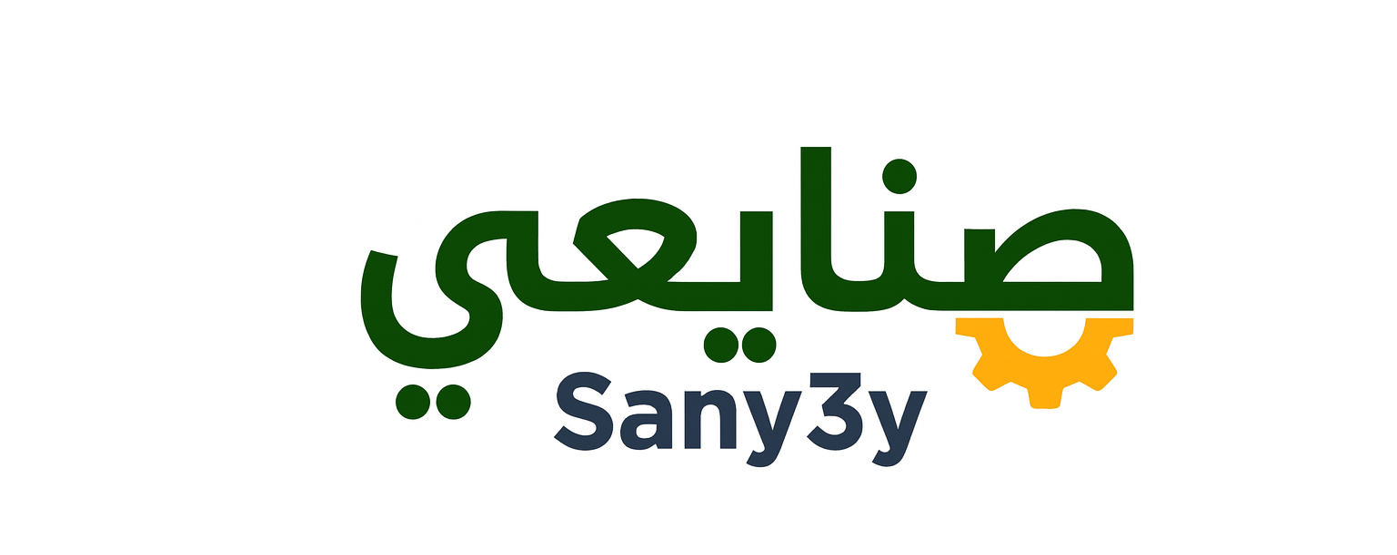










PRESENTATION ON
Sany3y
Full-Stack Maintenance Platform
ASP.NET Core MVC
Entity Framework
C#

Slide 2










Problem Statement
Fragmented Maintenance Processes
Introducing Sany3y
Communication Breakdown
Streamlined Solution
Disorganized communication between customers, technicians, and administrators
Centralized platform for efficient maintenance management
App-Driven Experience
Delayed Responses
Seamless service booking and tracking through intuitive interface
Manual processes lead to significant delays in service requests
Structured Interaction
Lack of Transparency
Clear workflow between customers, technicians, and administrators
No real-time tracking or status updates for service requests
User Frustration
Efficient Service Delivery
Cumbersome experience leading to dissatisfaction
Transforming disorganized processes into a seamless experience
Sany3y - Full-Stack Maintenance Platform

Slide 3

















Project Objectives
Functional Objectives
Non-Functional Objectives
Key features and capabilities the platform must deliver
Quality attributes and system requirements
User Registration & Authentication
Security
Secure user and technician management
Data privacy and protection
Service Booking & Request Management
Performance
Service request tracking and management
Fast response times
Technician Assignment & Dispatch
Scalability
Efficient request allocation to technicians
Support growing user base
Payment Processing
Usability
Secure payment integration
User-friendly interface
Feedback & Rating System
Reliability
User reviews and feedback collection
High availability
Sany3y - Full-Stack Maintenance Platform

Slide 4

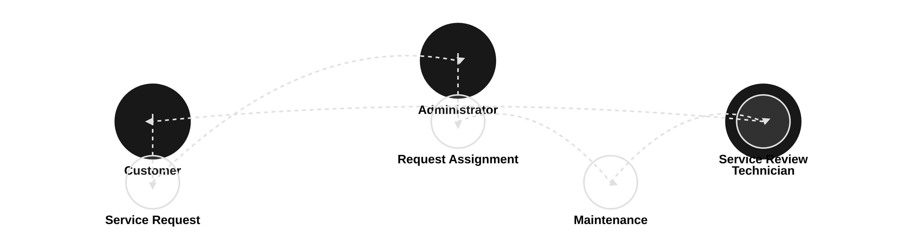






High-Level System Overview
Platform orchestrates interactions between customers, technicians, and administrators for efficient maintenance service delivery
Customer Experience
Technician Efficiency
Administrative Control
Streamlined service requests with real-time status updates and transparent communication
Optimized assignment and scheduling with clear instructions and location tracking
Comprehensive dashboard for monitoring, managing resources, and analyzing service trends
Sany3y - Full-Stack Maintenance Platform

Slide 5












Technology Stack
C#
ASP.NET Core MVC
SQL Server
Primary programming language for business logic
Framework for building backend APIs
Relational database for data storage
Bootstrap
jQuery
Entity Framework
CSS framework for UI design
JavaScript library for client-side interactivity
ORM for database interactions
Sany3y - Full-Stack Maintenance Platform

Slide 6









Architectural Flow
Domain Layer
Core business logic & entities
Application Layer
Use cases & application services
Presentation Layer
Controllers & UI components
Infrastructure Layer
Repositories & external services
Sany3y - Full-Stack Maintenance Platform

Slide 7



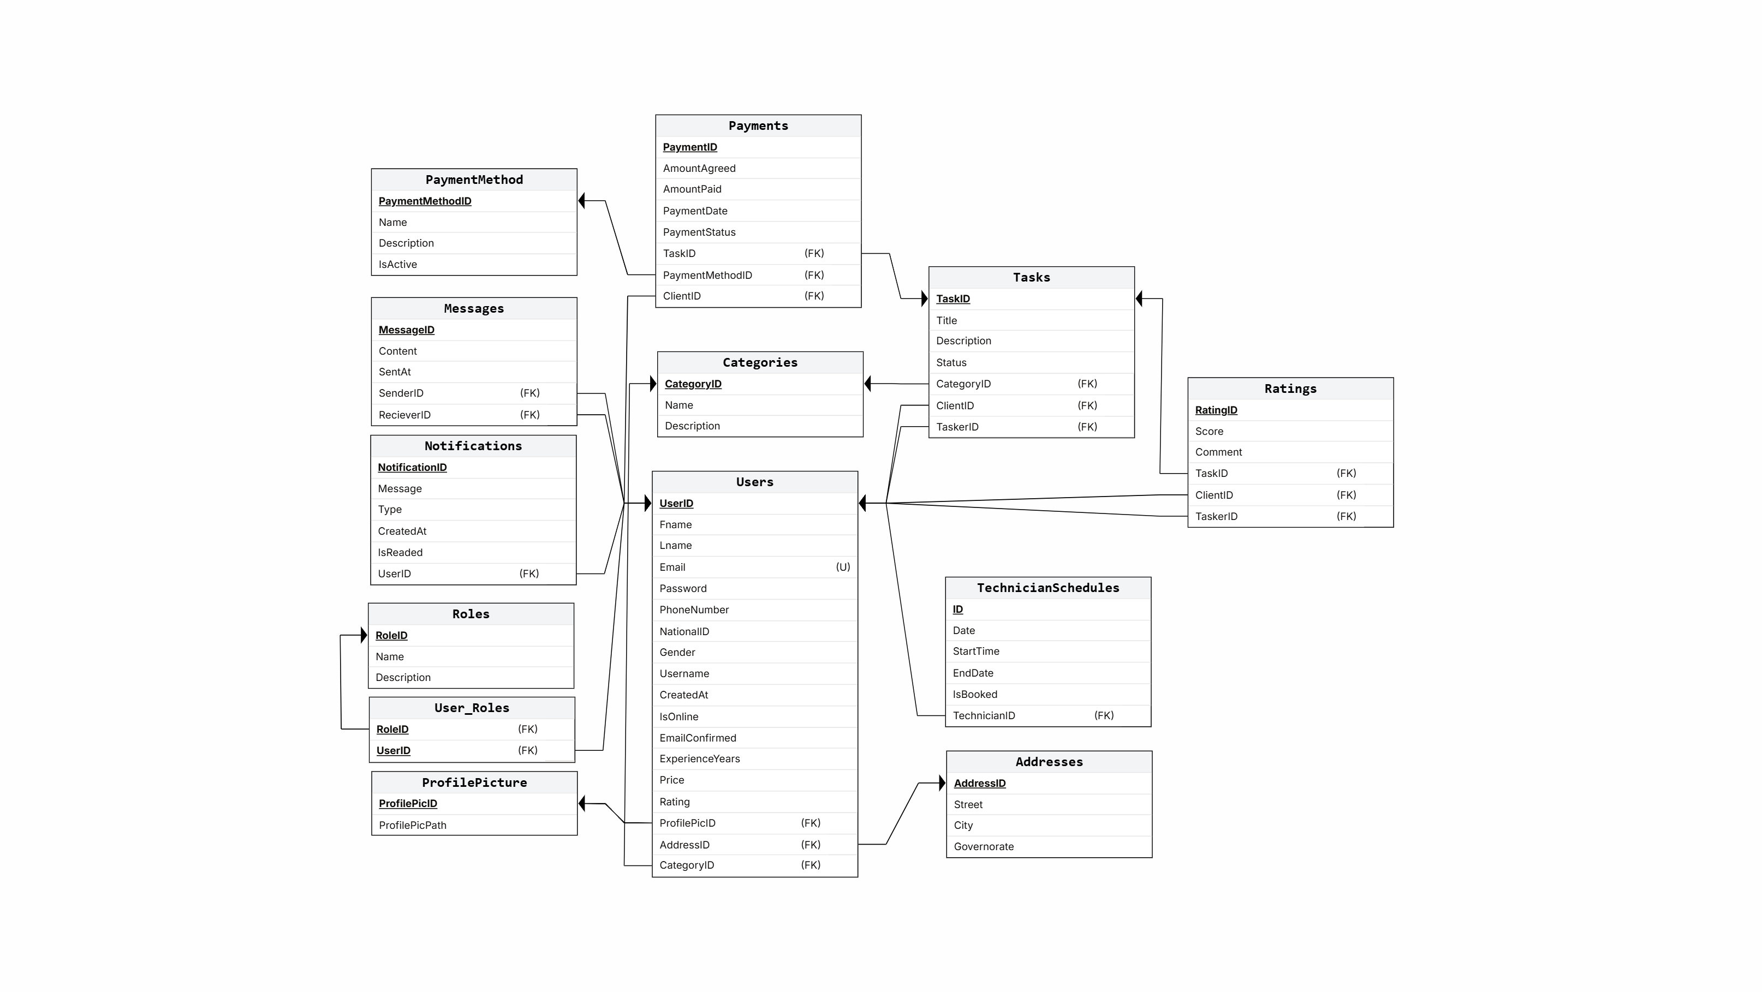



Database Design (ERD)
Data Integrity
Foreign Key Constraints
Maintains referential integrity
Normalization
Reduces data redundancy
Indexing
Optimizes query performance
Sany3y - Full-Stack Maintenance Platform

Slide 8











OOP and SOLID Principles
SOLID Principles
Implementation Example
Single Responsibility Principle
// BookingService handles business logic public class BookingService : IBookingService // Constructor injection for dependency public BookingService(IBookingRepository bookingRepository) // Single responsibility: business logic only public async Task<bool> CreateBooking(BookingDto bookingDto) // Business logic for creating a booking var booking = new Booking { // map properties }; return await _bookingRepository.AddAsync(booking); // Repository handles data access - separate concern public class BookingRepository : IGenericRepository<Booking> public async Task<bool> AddAsync(Booking entity)
Each class has one reason to change
Open/Closed Principle
Software entities open for extension, closed for modification
Liskov Substitution Principle
Subtypes must be substitutable for their base types
Dependency Inversion Principle
High-level modules should not depend on low-level modules
Sany3y - Full-Stack Maintenance Platform

Slide 9








Potential Challenges
Real-time Technician Management
Data Security & Privacy
Ensuring accurate updates on technician availability and efficient dispatching.
Handling sensitive data requires stringent security measures to protect against breaches.
Mitigation Strategy
Mitigation Strategy
Implement real-time communication (WebSockets via SignalR) and scheduling algorithms.
Employ encryption, implement strong authentication, and conduct regular security audits.
Platform Scalability
System Reliability
Maintaining performance as user base and service requests grow.
Ensuring high availability and minimizing downtime that impacts user satisfaction.
Mitigation Strategy
Design for scalability using cloud-native services, efficient indexing, and caching.
Mitigation Strategy
Implement monitoring, robust error handling, and design for high availability.
Sany3y - Full-Stack Maintenance Platform

Slide 10



















Summary and Deliverables
Project Success
Technical Implementation
Sany3y successfully delivers a robust full-stack maintenance platform, showcasing proficiency in modern development practices and technologies.
Technologies Used
ASP.NET Core MVC
Entity Framework
C#
Clean Architecture
Bootstrap
jQuery
Key Deliverables
User-friendly interface for service booking and management
Key Technical Features
Streamlined service request workflow from booking to completion
Secure user authentication and authorization
Scalable backend infrastructure with clean architecture
Layered architecture ensuring separation of concerns
Implementation of SOLID principles for maintainable code
Dependency injection for loose coupling
Comprehensive admin dashboard for platform management
Comprehensive testing strategy for reliability
Sany3y - Full-Stack Maintenance Platform

Slide 11







Thank You & Q&A
Thank You!
Thank you for your attention. The Sany3y project demonstrates proficiency in ASP.NET Core MVC and Clean Architecture.
User-friendly Interface
Streamlined Service Booking
Scalable Backend
Questions & Answers
Stay Connected
Our team
Feel free to ask about implementation aspects
December 5, 2025
Technical architecture and design decisions
Project challenges and enhancements
Sany3y - Full-Stack Maintenance Platform

